Slide 1

ICT504 IT Strategy & Leadership Week 8 Portfolio of Business Applications Dr. Farshid Keivanian

Slide 2
Lecture Outline
Application portfolio management.
Generic application management strategies.
ICT strategy formulation.
Portfolio management principles.
Managing portfolio in large organisation.

Slide 3
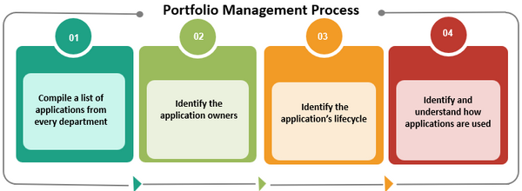
Introduction to Application Portfolio Management
Title: What is Application Portfolio Management?
It’s like managing your phone apps: You want to keep the useful ones, remove unused ones, and update the ones you need.
In business, we manage all software applications used in different departments to make sure they give the most value.

Slide 4
Introduction to Application Portfolio Management
The goal: Create a single, smart list (portfolio) of all ICT applications that helps the organisation run better.

Slide 5
Step 1 – Compile a List of Applications
Make an App Inventory
Like checking every room in a house to see what appliances you have.
Each department lists all the software they use.
This is the foundation – we can’t manage what we don’t know!
Analogy: Like writing down all the subscriptions (Netflix, Spotify, etc.) in your household to see what’s being paid for.

Slide 6
Step 2 – Identify the Application Owners
Who Owns What?
Every app needs a “go-to” person: someone responsible for it.
Owners help us know why the app is used, who uses it, and how it’s managed.
Analogy: Like knowing who in your family signed up for which streaming service – so you know who to ask about it.

Slide 7
Step 3 – Identify the Application’s Lifecycle
Understand the App’s Lifespan
When was it installed? Is it still being updated? Is it near its end?
Helps in planning upgrades, replacements, or removals.
Analogy: Like checking the expiry date of food in your fridge – keep what’s fresh, toss what’s expired.

Slide 8
Step 4 – How is the App Used?
Know the Purpose and Usage
Why do people use this app? How often is it used? Is there a better option?
Usage data helps us decide whether to invest more, train staff, or remove it.
Analogy: Like noticing you haven’t used your gym membership in 6 months – do you still need it?

Slide 9
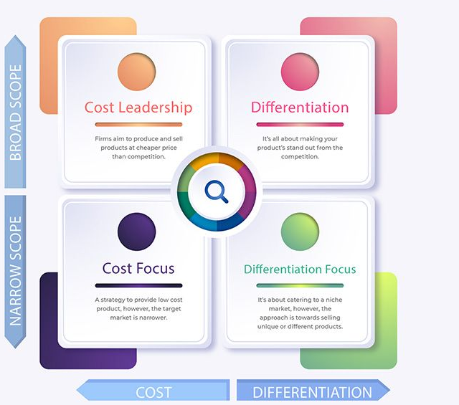
Generic Application Management Strategies
https://managementweekly.org/porters-generic-competitive-strategies/

Slide 10
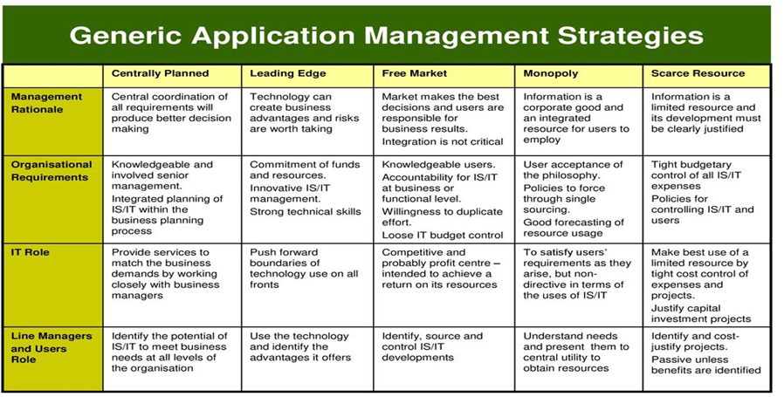
Generic Application Management Strategies (Cont)
Overview of Generic Application Management Strategies
Strategy Choices for Managing Applications
Businesses choose how to manage and improve apps based on cost and uniqueness (differentiation).
G.L. Parsons, Fitting Information Systems Technology to the Corporate Needs: The Linking Strategy, Harvard Business School Press, Boston, Teaching Note 9-183-176, 1986.

Slide 11
Generic Application Management Strategies (Cont)
Michael Porter suggests 4 main strategies depending on target market (broad or narrow) and focus (cost or value).
Analogy: Think of running a food truck. Do you want to be the cheapest, the fanciest, or serve a niche?
G.L. Parsons, Fitting Information Systems Technology to the Corporate Needs: The Linking Strategy, Harvard Business School Press, Boston, Teaching Note 9-183-176, 1986.

Slide 12
Cost Leadership
Strategy 1 – Cost Leadership (Broad & Cheap)
Goal: Offer apps at a lower cost than competitors.
Used when targeting all departments or users.
Efficient, standardised apps, fewer features.
Example: A university uses Google Workspace (Docs, Sheets, Drive) for everyone, as it's cheap and functional.
G.L. Parsons, Fitting Information Systems Technology to the Corporate Needs: The Linking Strategy, Harvard Business School Press, Boston, Teaching Note 9-183-176, 1986.

Slide 13
Differentiation
Strategy 2 – Differentiation (Broad & Unique)
Goal: Provide high-quality, unique apps to stand out.
Focus on user experience, customisation, or innovation.
Used organisation-wide to build a strong identity.
Example: A creative agency uses Adobe Creative Cloud – expensive, but offers unmatched features.
G.L. Parsons, Fitting Information Systems Technology to the Corporate Needs: The Linking Strategy, Harvard Business School Press, Boston, Teaching Note 9-183-176, 1986.

Slide 14
Cost Focus
Strategy 3 – Cost Focus (Narrow & Cheap)
Goal: Serve a small group with low-cost apps.
Useful for small departments with tight budgets.
Example: The HR team uses a basic payroll system just for internal use – affordable, but limited.
G.L. Parsons, Fitting Information Systems Technology to the Corporate Needs: The Linking Strategy, Harvard Business School Press, Boston, Teaching Note 9-183-176, 1986.

Slide 15
Differentiation Focus
Strategy 4 – Differentiation Focus (Narrow & Unique)
Goal: Serve a specific niche with specialised, unique apps.
Higher cost is acceptable if it meets special needs.
Example: A medical research lab uses advanced data analysis software (e.g., MATLAB, SPSS) tailored to their work.
G.L. Parsons, Fitting Information Systems Technology to the Corporate Needs: The Linking Strategy, Harvard Business School Press, Boston, Teaching Note 9-183-176, 1986.

Slide 16
Discussion Research Question
Question: How can an organisation decide between Cost Leadership and Differentiation when managing its application portfolio? What internal and external factors should influence this decision?
Purpose: To help students critically think about strategic decision-making in real-world IT management scenarios.
G.L. Parsons, Fitting Information Systems Technology to the Corporate Needs: The Linking Strategy, Harvard Business School Press, Boston, Teaching Note 9-183-176, 1986.

Slide 17
Discussion Research Question
Student Response Guide: Students should explore:
Internal factors: budget, user needs, technical capacity, staff skill levels, organisational goals.
External factors: competitor strategies, market expectations, technological trends, vendor offerings.
Trade-offs: Cost savings vs. innovation; simplicity vs. performance; standardisation vs. customisation.
G.L. Parsons, Fitting Information Systems Technology to the Corporate Needs: The Linking Strategy, Harvard Business School Press, Boston, Teaching Note 9-183-176, 1986.

Slide 18
Discussion Research Question
Example Insight: A logistics company may choose Cost Leadership for warehouse systems but Differentiation for its customer-facing tracking app to gain a competitive edge.
G.L. Parsons, Fitting Information Systems Technology to the Corporate Needs: The Linking Strategy, Harvard Business School Press, Boston, Teaching Note 9-183-176, 1986.

Slide 19
Problem-Solving Question
Scenario-Based Question: A university has a limited IT budget and wants to upgrade its student learning platform. Should it adopt a Cost Focus or Differentiation Focus strategy for its postgraduate research programs? Justify your answer with at least two reasons.
G.L. Parsons, Fitting Information Systems Technology to the Corporate Needs: The Linking Strategy, Harvard Business School Press, Boston, Teaching Note 9-183-176, 1986.

Slide 20
Problem-Solving Question
Model Answer: The university should adopt a Differentiation Focus strategy for its postgraduate research programs.
Justification:
Postgraduate research needs advanced, unique tools like Turnitin, SPSS, or MATLAB – generic platforms may not support research-specific needs.
High-quality tools can attract top students and researchers, aligning with the university’s academic reputation goals, even if the cost is higher for this smaller user base.
G.L. Parsons, Fitting Information Systems Technology to the Corporate Needs: The Linking Strategy, Harvard Business School Press, Boston, Teaching Note 9-183-176, 1986.

Slide 21
Problem-Solving Question
Extra Note: Meanwhile, undergrad courses could still use a Cost Leadership approach (e.g., Moodle, Blackboard) to keep overall costs low.
G.L. Parsons, Fitting Information Systems Technology to the Corporate Needs: The Linking Strategy, Harvard Business School Press, Boston, Teaching Note 9-183-176, 1986.

Slide 22
ICT Strategy Formulation
Organisation-led = Big picture planning for the entire company.
Business-led = Focuses on one department's growth.
Systematic = Uses data and analysis to plan smart.
Administrative = Focuses on saving money, not growth.

Slide 23
ICT Strategy Formulation
Analogy: Like choosing a gym membership — are you deciding based on budget, goals, or data?
🇦🇺 Australian Example: The University of Sydney uses a systematic approach to upgrade systems, ensuring tech aligns with student needs.

Slide 24
ICT Strategy Formulation
Discussion Question: Which approach is best for a start-up vs. a government agency? Why?
Hands-on Activity: Pick a department (e.g., Marketing). Propose which strategy fits best and justify your choice.
Debate Prompt: "Administrative approaches limit innovation." Agree or disagree?

Slide 25
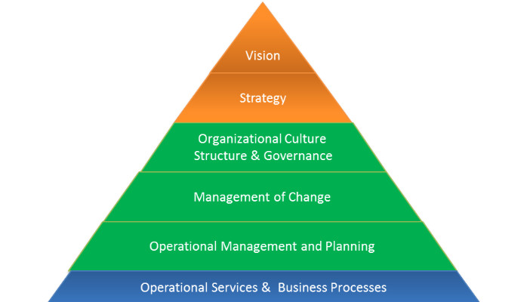
Portfolio Management Principles
Portfolio management starts from vision and ends at daily operations.
Align ICT with goals, culture, and changes.
https://www.linkedin.com/pulse/16-principles-portfolio-management-gary-scherling-pmp-p2p-pmoc/

Slide 26
Portfolio Management Principles
Analogy: Like building a house — start with the blueprint (vision), then bricks (operations).
🇦🇺 Australian Example: Telstra aligns IT services with their sustainability vision, using this layered structure.

Slide 27
Portfolio Management Principles
Discussion Question: How does organisational culture affect ICT planning success?
Problem-Solving Activity: Given a case where “Vision” is strong but operations are weak — what’s the result and how would you fix it?

Slide 28
Portfolio Management Principles (Cont)
Apps have life cycles just like products.
Funding, skills, and business value matter for decisions.
Analogy: Apps are like cars — they need maintenance, skilled users, and should match purpose.
🇦🇺 Australian Example: Woolworths retires older stock management systems when ROI declines.

Slide 29
Portfolio Management Principles (Cont)
Discussion Question: What risks arise if an organisation ignores the lifecycle of applications?
Hands-On: Make a table listing 3 apps you use. Note lifecycle stage, funding needs, and who should manage it.

Slide 30
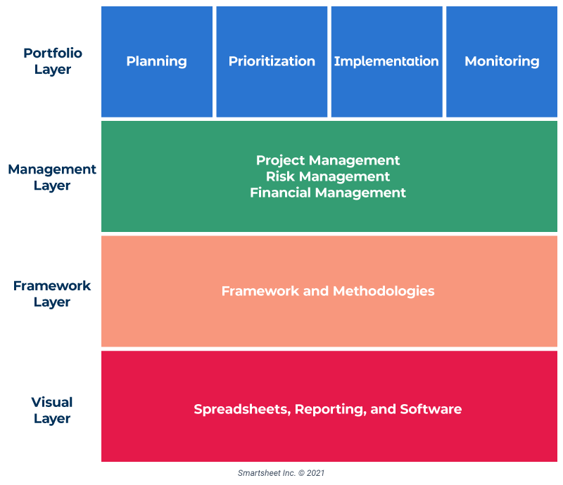
IT Portfolio Management Strategies
https://www.smartsheet.com/content/it-portfolio-management
Layers: Planning, Management (Risk/Finance), Framework, Visual tools.
Each layer supports the next.

Slide 31
IT Portfolio Management Strategies
Analogy: Like running a concert – plans, managers, schedules, and visual boards must all align.
🇦🇺 Australian Example: Commonwealth Bank uses Jira and Smartsheet for visual and strategic planning layers.
Discussion Question: How do frameworks like Agile or ITIL fit into this layered approach?
Problem-Solving: You're an IT manager. Map a project using this 4-layer strategy model.

Slide 32
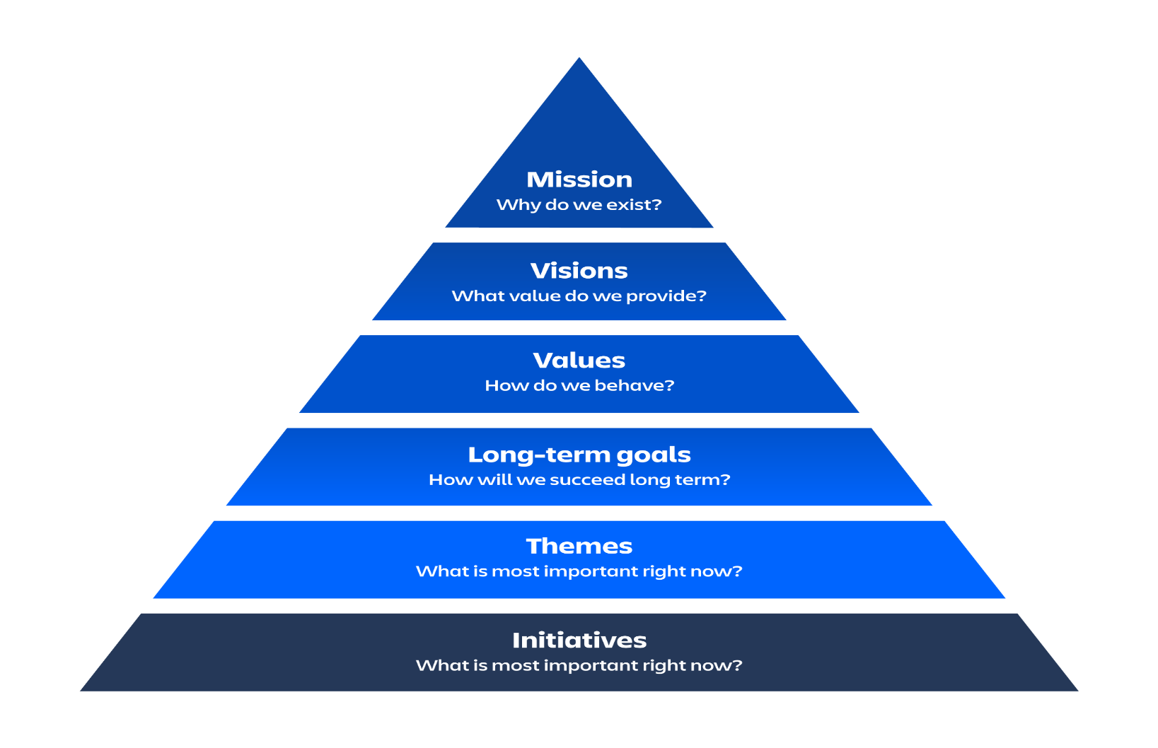
Objective of Portfolio Mgt Strategy
Strategy aligns from high-level mission down to daily initiatives.
Clarity at each level boosts success.
https://www.atlassian.com/agile/agile-at-scale/lean-portfolio-management

Slide 33
Objective of Portfolio Mgt Strategy
Analogy: Like planning a wedding – you need big goals (marriage), values (budget, guests), and actions (booking venues).
🇦🇺 Australian Example: Monash University sets a mission to digitalise learning — this breaks down into short-term LMS improvements.
https://www.atlassian.com/agile/agile-at-scale/lean-portfolio-management

Slide 34
Objective of Portfolio Mgt Strategy
Discussion: What happens if “values” and “initiatives” don’t align?
Hands-On: Pick a real-world ICT mission (e.g., digital inclusion). Break it into the 6 layers shown in the pyramid.
https://www.atlassian.com/agile/agile-at-scale/lean-portfolio-management

Slide 35
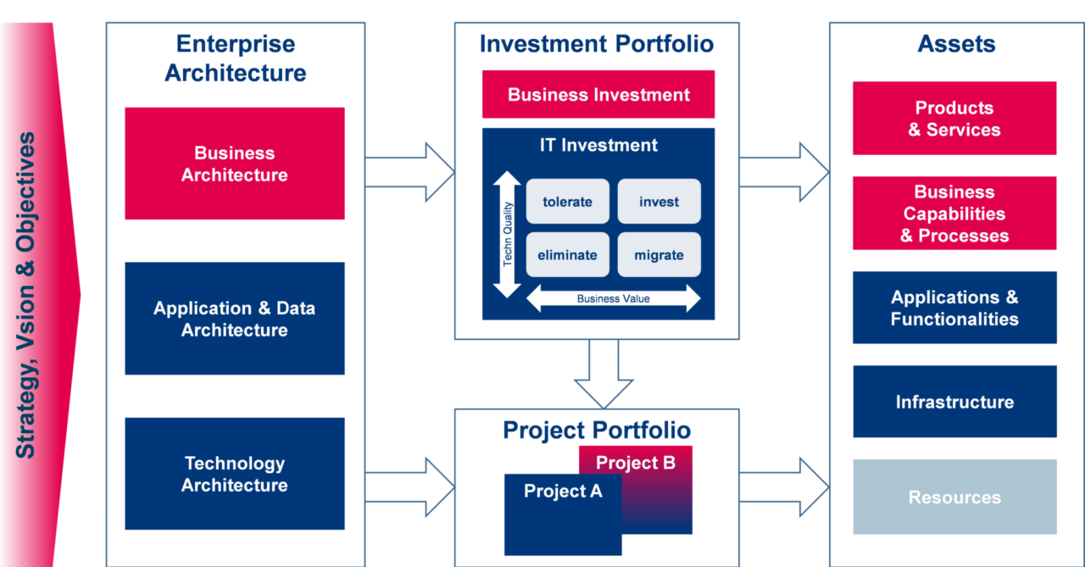
Managing Application in Large Orgs
https://bizzdesign.com/blog/application-portfolio-management-towards-value-driven-architecting/
Start with architecture → assess investment portfolio → support assets like apps, infrastructure, and people.
Use business value to decide: Invest, Tolerate, Eliminate, Migrate.

Slide 36
Managing Application in Large Orgs
Analogy: Like managing a wardrobe — keep good clothes, donate old ones, and buy only what fits your goals.
🇦🇺 Australian Example: Australian Taxation Office audits old systems and migrates high-risk apps to cloud platforms.
Discussion Question: Why is "tolerating" some applications a valid strategy?

Slide 37
Managing Application in Large Orgs
Problem-Solving: Given a legacy system with medium risk and low ROI — what’s your move (invest, eliminate, migrate, tolerate)? Why?
Role-Play Debate: CIO A: “Eliminate all legacy apps for agility.” CIO B: “Legacy systems are stable and low cost.” → Debate both positions.

Slide 38
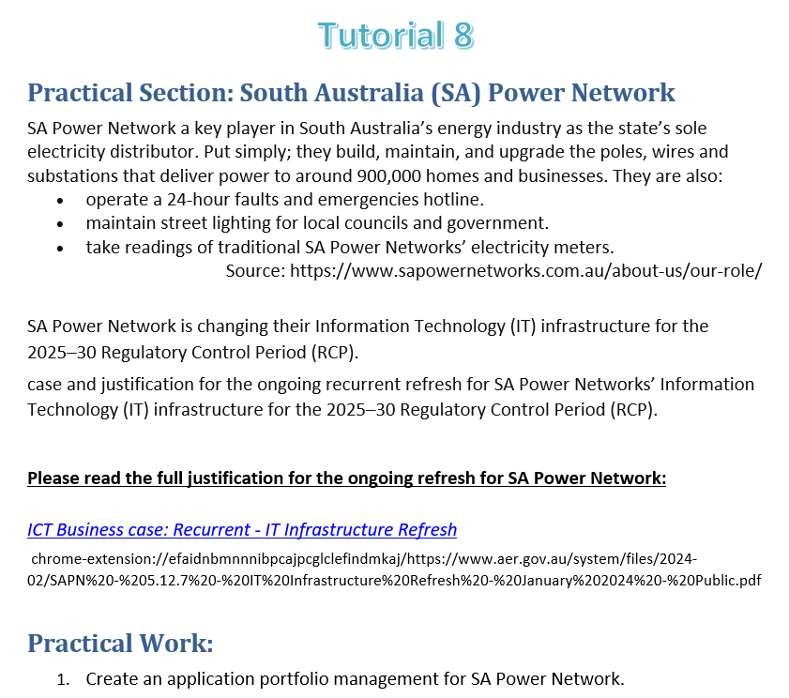
https://www.aer.gov.au/system/files/2024-02/SAPN%20-%205.12.7%20-%20IT%20Infrastructure%20Refresh%20-%20January%202024%20-%20Public.pdf

Slide 39

Reading Materials

Slide 40
Articles
E.M. Daniel and J.M. Ward, ‘Improving the business-IT relationship with IT project portfolio management’, Cutter IT Journal,28, 1, 2015, 20–24.
J.M. Ward, ‘Information systems and technology: application portfolio management—an assessment of matrix-based analysis’, Journal of Information Technology, 3, 3, 1988, 205–215.
F.W. McFarlan, ‘Portfolio approach to information systems’, Harvard Business Review, 59, 5, 1981, 143–150.
G.L. Parsons, Fitting Information Systems Technology to the Corporate Needs: The Linking Strategy, Harvard Business School Press, Boston, Teaching Note 9-183-176, 1986. 8. R. Simon, ‘Control in an age of empowerment’, Harvard Business Review, March–April, 1995, 80–88.
E. Daniel, J. Ward and A. Franken, ‘A dynamic capabilities perspective of IS project portfolio management’, Journal of Strategic Information Systems,23, 2014, 95–111.

